Slide 1

Chapter 11 Data Link Control
11.1
Copyright © The McGraw-Hill Companies, Inc. Permission required for reproduction or display.

Slide 2
11-1
FRAMING
The data link layer needs to pack bits into frames, so that each frame is distinguishable from another. Our postal system practices a type of framing. The simple act of inserting a letter into an envelope separates one piece of information from another; the envelope serves as the delimiter.
Topics discussed in this section:
Fixed-Size Framing Variable-Size Framing
11.2

Slide 3
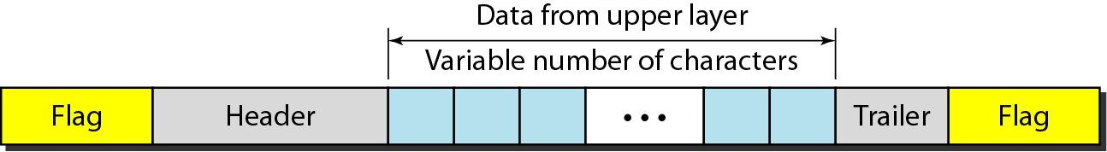
Figure 11.1 A frame in a character-oriented protocol
11.2

Slide 4
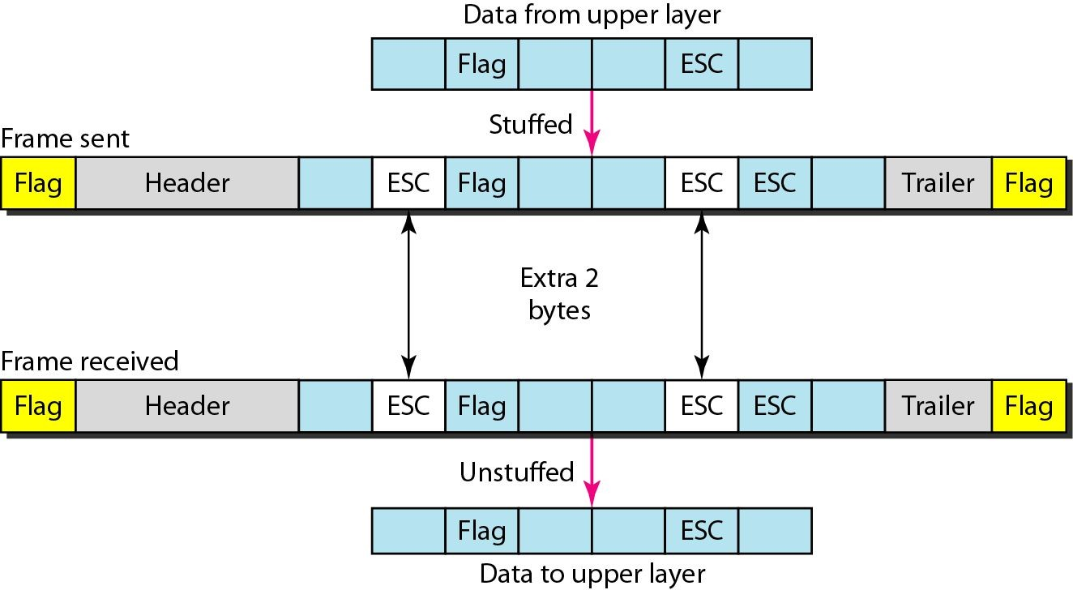
Figure 11.2 Byte stuffing and unstuffing
11.2

Slide 5



Note
Byte stuffing is the process of adding 1 extra byte whenever there is a flag or escape character in the text.
11.2

Slide 6
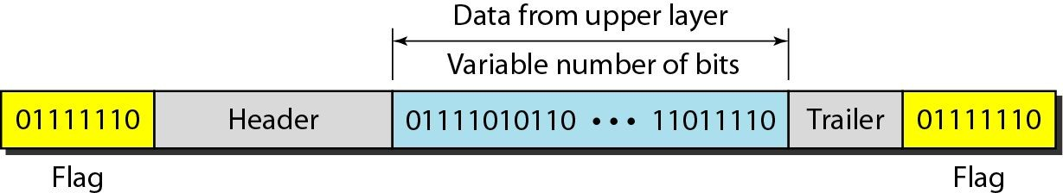
Figure 11.3 A frame in a bit-oriented protocol
11.2

Slide 7
Note
Bit stuffing is the process of adding one extra 0 whenever five consecutive 1s follow a 0 in the data, so that the receiver does not mistake
the pattern 0111110 for a flag.
11.2

Slide 8
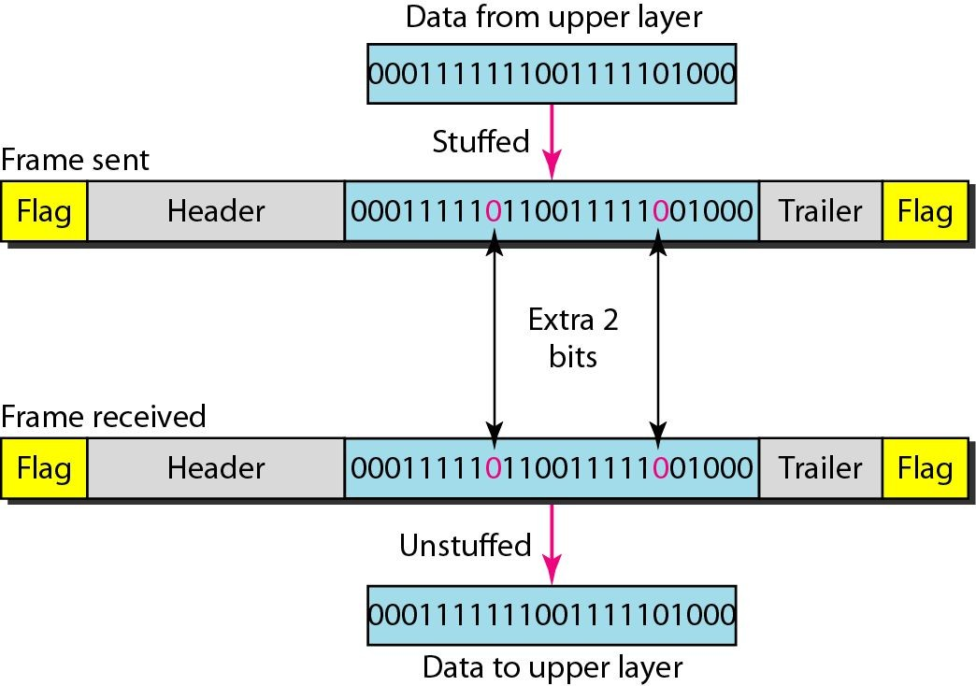
Figure 11.4 Bit stuffing and unstuffing
11.2

Slide 9
11-2 FLOW AND ERROR CONTROL
The most important responsibilities of the data link layer are flow control and error control. Collectively, these functions are known as data link control.
Topics discussed in this section:
Flow Control Error Control
11.2

Slide 10
Note
Flow control refers to a set of procedures used to restrict the amount of data
that the sender can send before waiting for acknowledgment.

Slide 11
Note
Error control in the data link layer is based on automatic repeat request, which is the retransmission of data.

Slide 12
11-3 PROTOCOLS
Now let us see how the data link layer can combine framing, flow control, and error control to achieve the delivery of data from one node to another. The protocols are normally implemented in software by using one of the common programming languages. To make our discussions language-free, we have written in pseudocode a version of each protocol that concentrates mostly on the procedure instead of delving into the details of language rules.

Slide 13
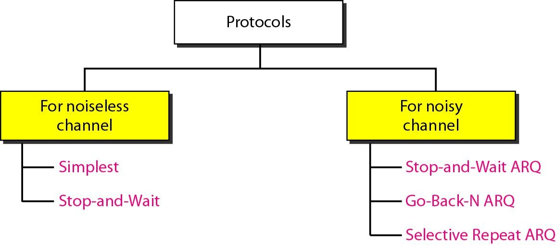
Figure 11.5 Taxonomy of protocols discussed in this chapter

Slide 14
11-4 NOISELESS CHANNELS
Let us first assume we have an ideal channel in which no frames are lost, duplicated, or corrupted. We introduce two protocols for this type of channel.
Topics discussed in this section:
Simplest Protocol
Stop-and-Wait Protocol

Slide 15
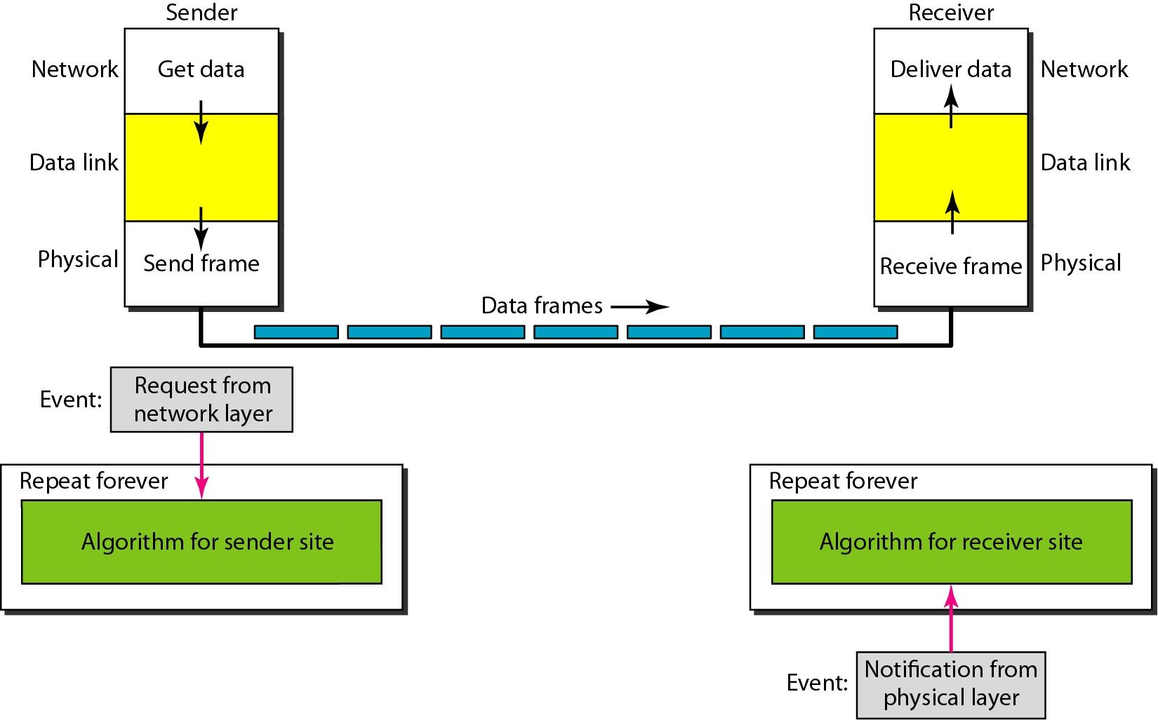
Figure 11.6 The design of the simplest protocol with no flow or error control

Slide 16
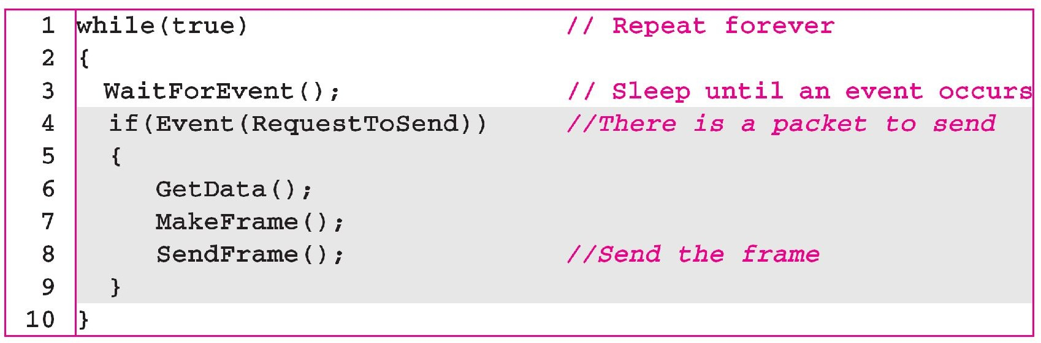
Algorithm 11.1 Sender-site algorithm for the simplest protocol

Slide 17
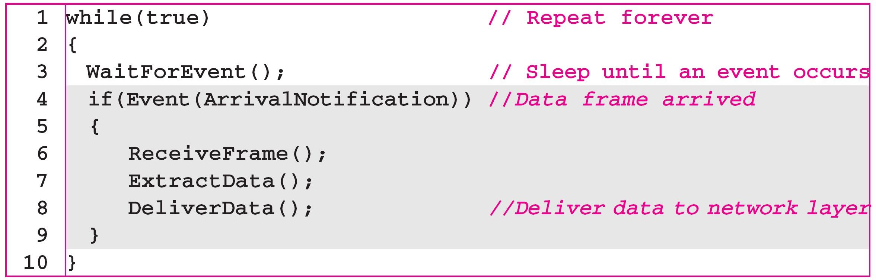
Algorithm 11.2 Receiver-site algorithm for the simplest protocol

Slide 18
Example 11.1
Figure 11.7 shows an example of communication using this protocol. It is very simple. The sender sends a sequence of frames without even thinking about the receiver. To send three frames, three events occur at the sender site and three events at the receiver site. Note that the data frames are shown by tilted boxes; the height of the box defines the transmission time difference between the first bit and the last bit in the frame.

Slide 19
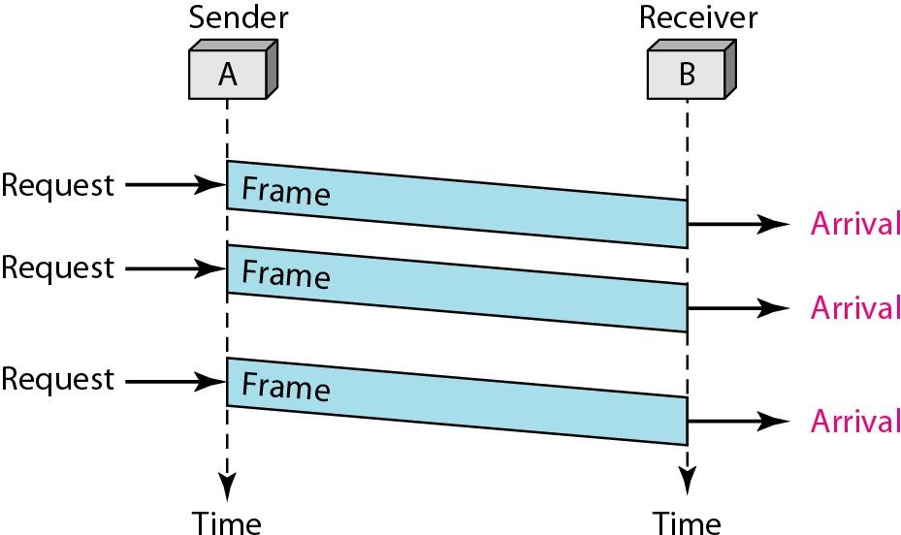
Figure 11.7 Flow diagram for Example 11.1

Slide 20
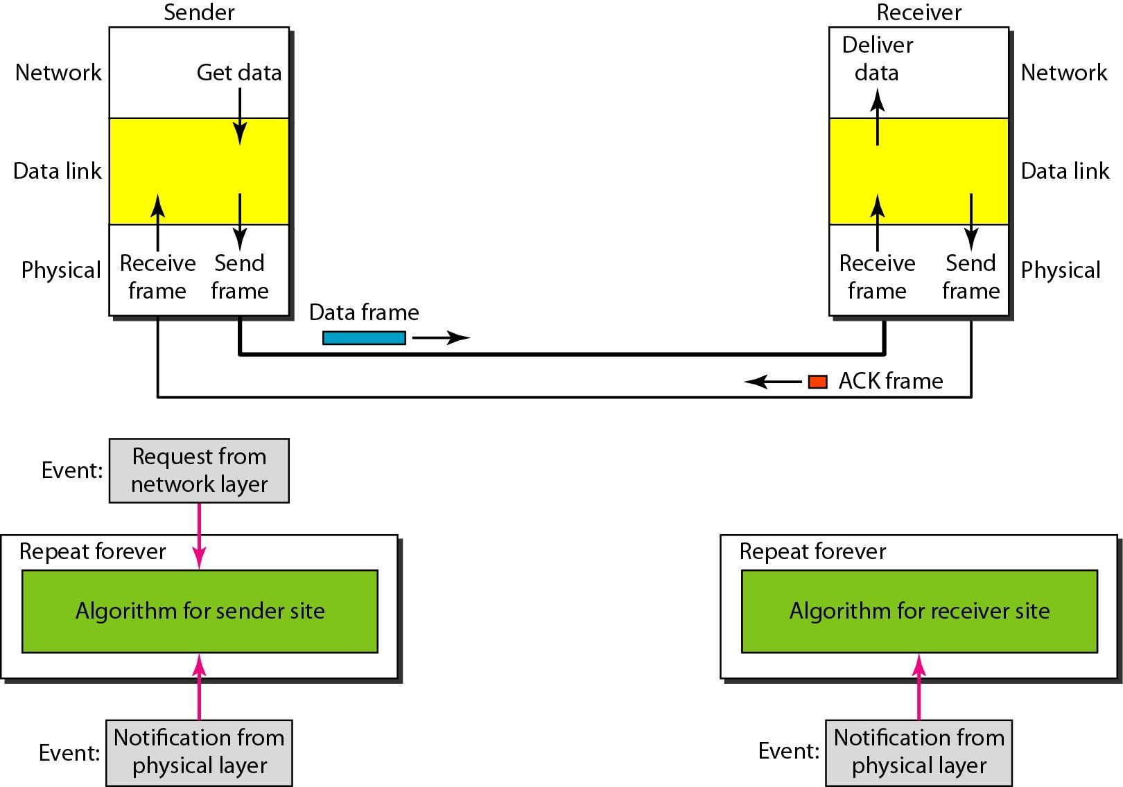
Figure 11.8 Design of Stop-and-Wait Protocol

Slide 21
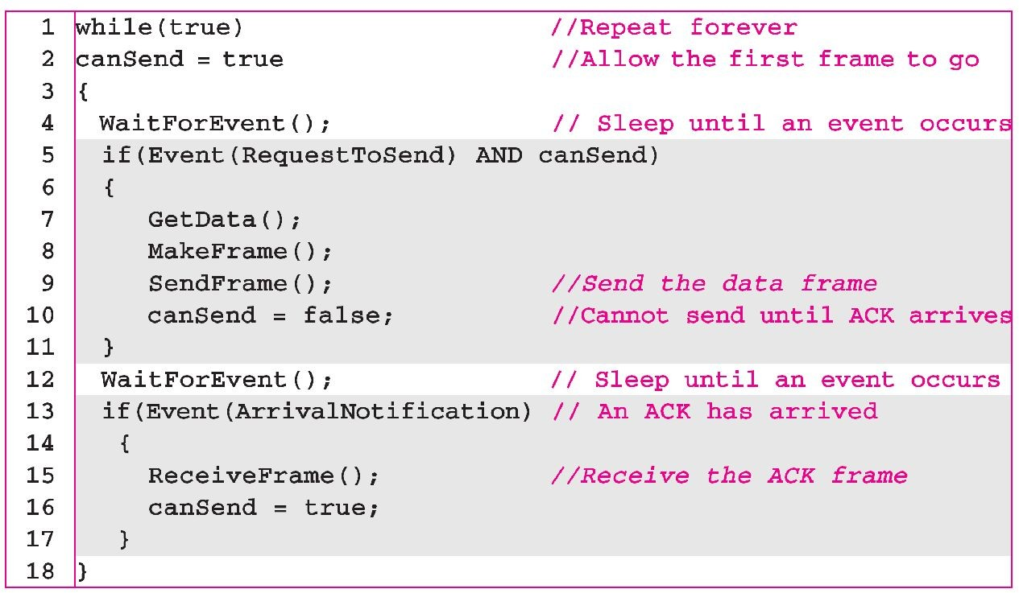
Algorithm 11.3 Sender-site algorithm for Stop-and-Wait Protocol

Slide 22
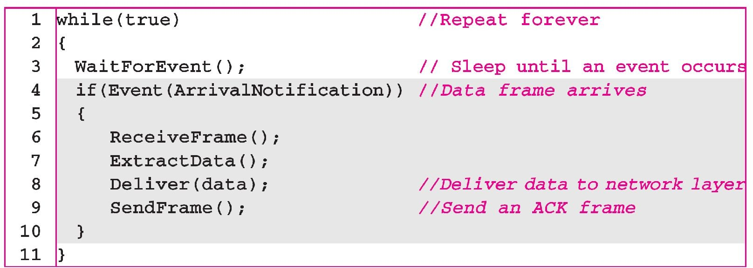
Algorithm 11.4 Receiver-site algorithm for Stop-and-Wait Protocol

Slide 23
Example 11.2
Figure 11.9 shows an example of communication using this protocol. It is still very simple. The sender sends one frame and waits for feedback from the receiver. When the ACK arrives, the sender sends the next frame. Note that sending two frames in the protocol involves the sender in four events and the receiver in two events.

Slide 24
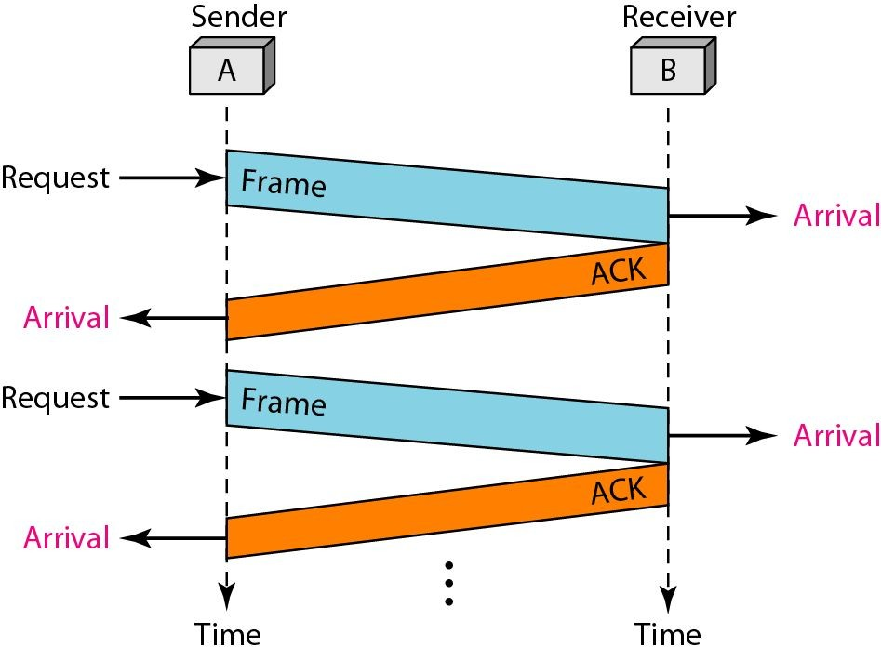
Figure 11.9 Flow diagram for Example 11.2

Slide 25
11-5 NOISY CHANNELS
Although the Stop-and-Wait Protocol gives us an idea of how to add flow control to its predecessor, noiseless channels are nonexistent. We discuss three protocols in this section that use error control.
Topics discussed in this section:
Stop-and-Wait Automatic Repeat Request Go-Back-N Automatic Repeat Request Selective Repeat Automatic Repeat Request

Slide 26
Note
Error correction in Stop-and-Wait ARQ is done by keeping a copy of the sent frame and retransmitting of the frame when the timer expires.

Slide 27
Note
In Stop-and-Wait ARQ, we use sequence numbers to number the frames.
The sequence numbers are based on modulo-2 arithmetic.

Slide 28
Note
In Stop-and-Wait ARQ, the acknowledgment number always announces in modulo-2 arithmetic the sequence number of the next frame expected.

Slide 29
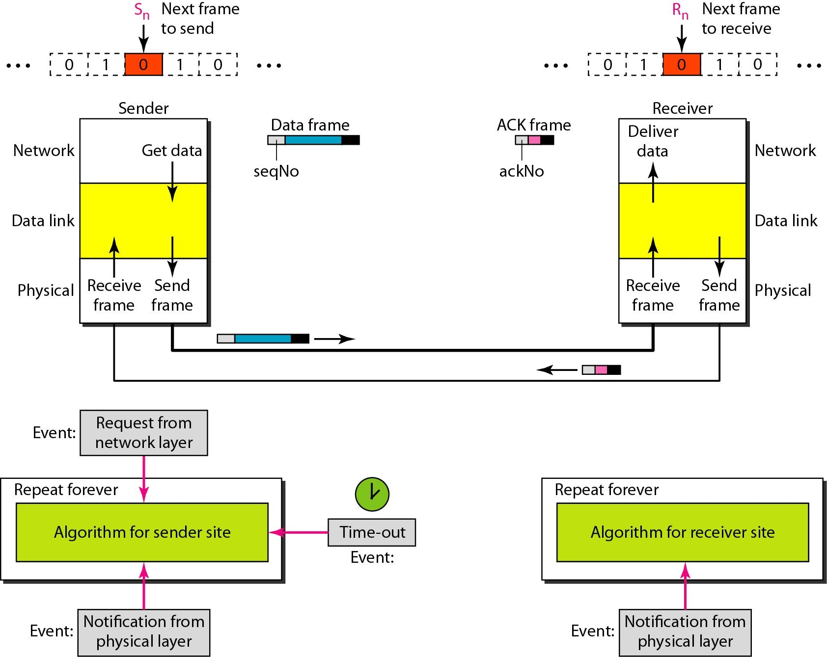
Figure 11.10 Design of the Stop-and-Wait ARQ Protocol

Slide 30
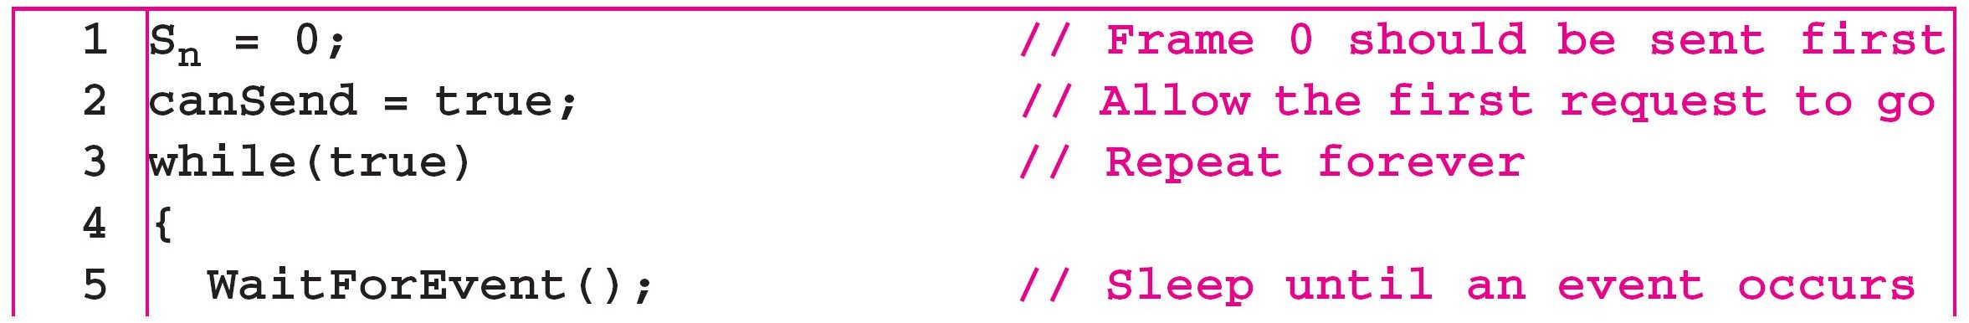
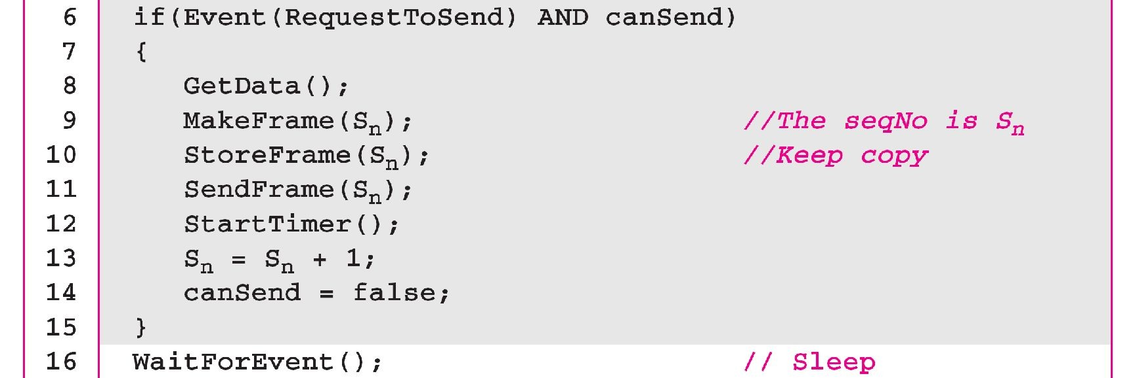
Algorithm 11.5 Sender-site algorithm for Stop-and-Wait ARQ
(continued
11.30
)

Slide 31
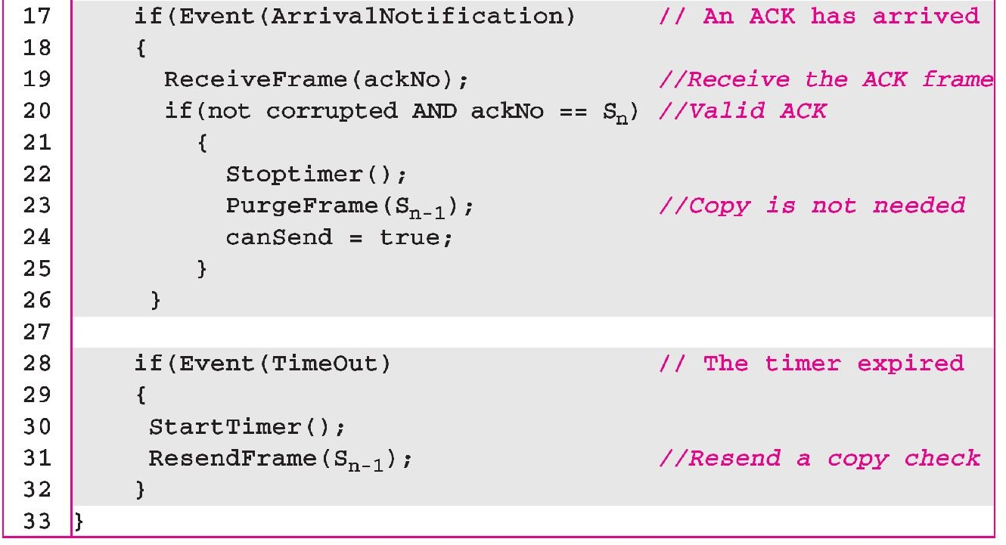
Algorithm 11.5 Sender-site algorithm for Stop-and-Wait ARQ
(continued
)

Slide 32
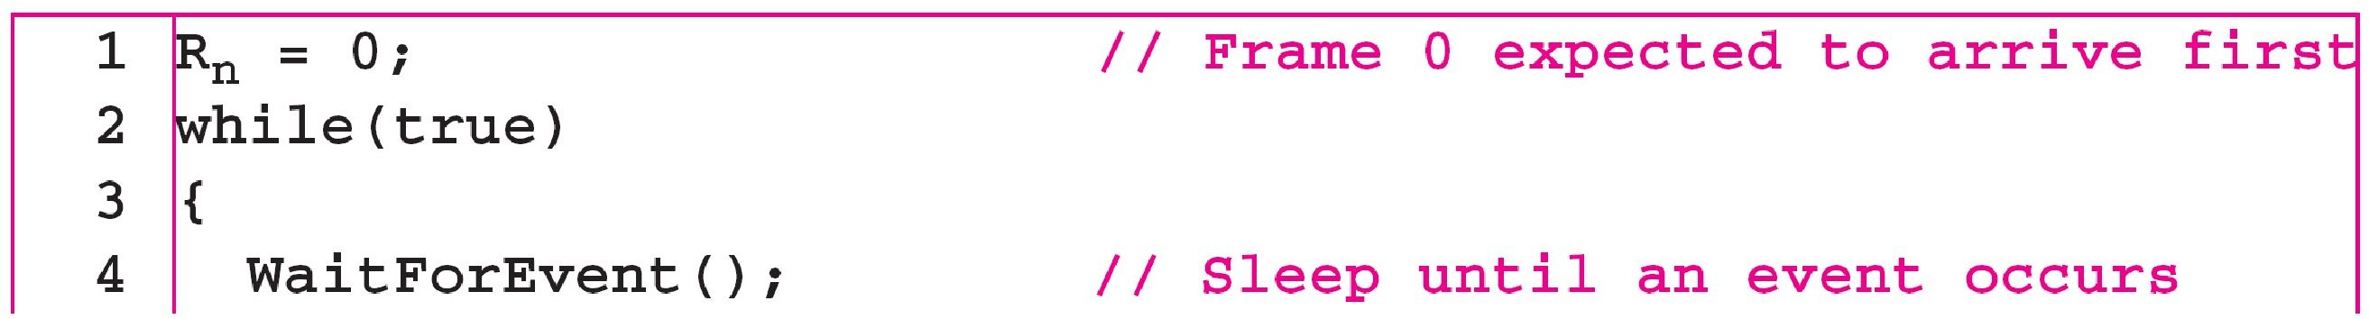
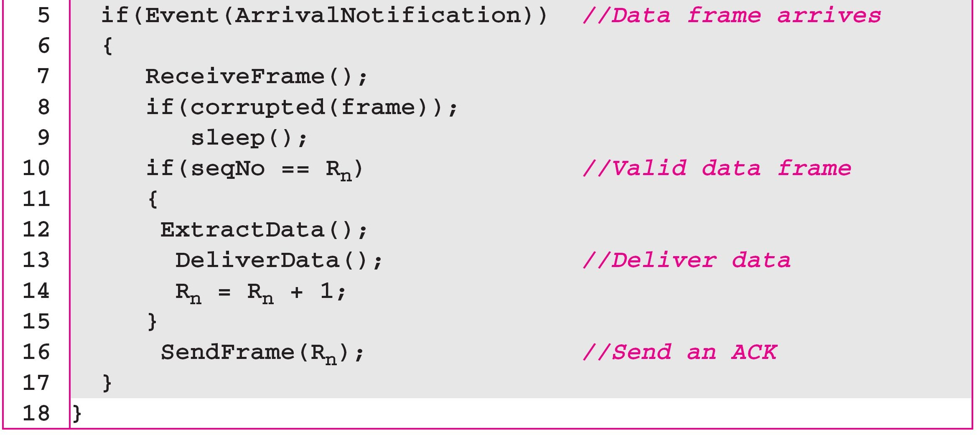
Algorithm 11.6 Receiver-site algorithm for Stop-and-Wait ARQ Protocol

Slide 33
Example 11.3
Figure 11.11 shows an example of Stop-and-Wait ARQ. Frame 0 is sent and acknowledged. Frame 1 is lost and resent after the time-out. The resent frame 1 is acknowledged and the timer stops. Frame 0 is sent and acknowledged, but the acknowledgment is lost. The sender has no idea if the frame or the acknowledgment is lost, so after the time-out, it resends frame 0, which is acknowledged.

Slide 34
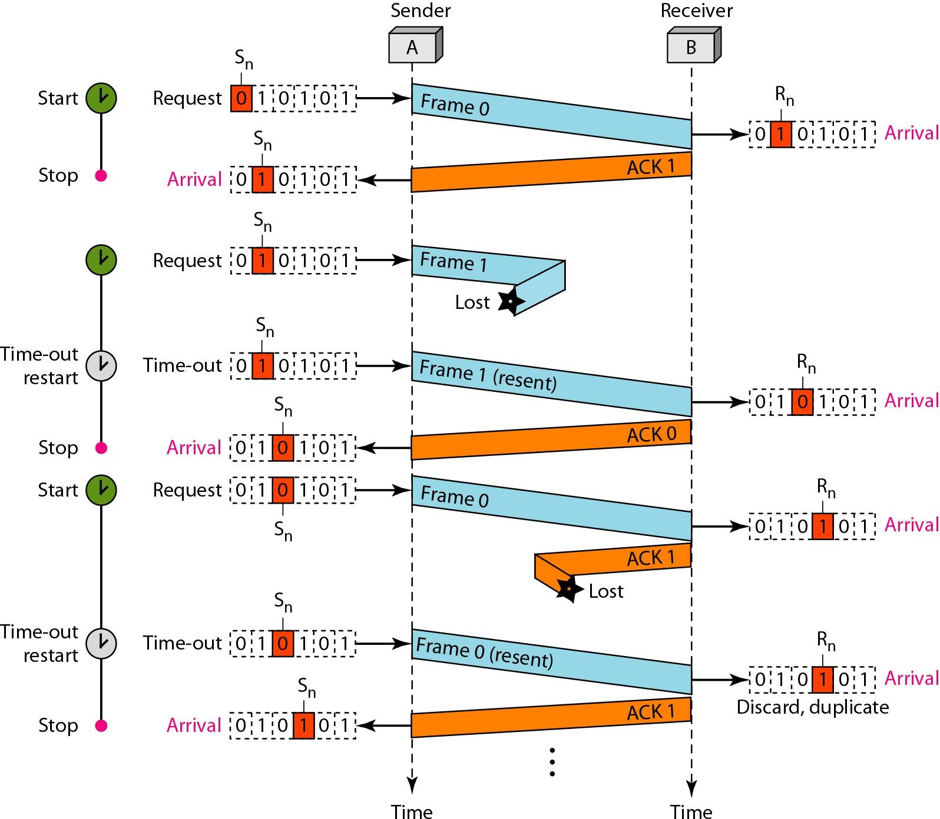
Figure 11.11 Flow diagram for Example 11.3

Slide 35
Example 11.4
Assume that, in a Stop-and-Wait ARQ system, the bandwidth of the line is 1 Mbps, and 1 bit takes 20 ms to make a round trip. What is the bandwidth-delay product? If the system data frames are 1000 bits in length, what is the utilization percentage of the link?
Solution
The bandwidth-delay product is

Slide 36
Example 11.4 (continued)
The system can send 20,000 bits during the time it takes for the data to go from the sender to the receiver and then back again. However, the system sends only 1000 bits. We can say that the link utilization is only 1000/20,000, or 5 percent. For this reason, for a link with a high bandwidth or long delay, the use of Stop-and-Wait ARQ wastes the capacity of the link.

Slide 37
Example 11.5
What is the utilization percentage of the link in Example 11.4 if we have a protocol that can send up to
15 frames before stopping and worrying about the acknowledgments?
Solution
The bandwidth-delay product is still 20,000 bits. The system can send up to 15 frames or 15,000 bits during a round trip. This means the utilization is 15,000/20,000, or 75 percent. Of course, if there are damaged frames, the utilization percentage is much less because frames have to be resent.

Slide 38
Note
In the Go-Back-N Protocol, the sequence numbers are modulo 2^{m},
where m is the size of the sequence number field in bits.

Slide 39
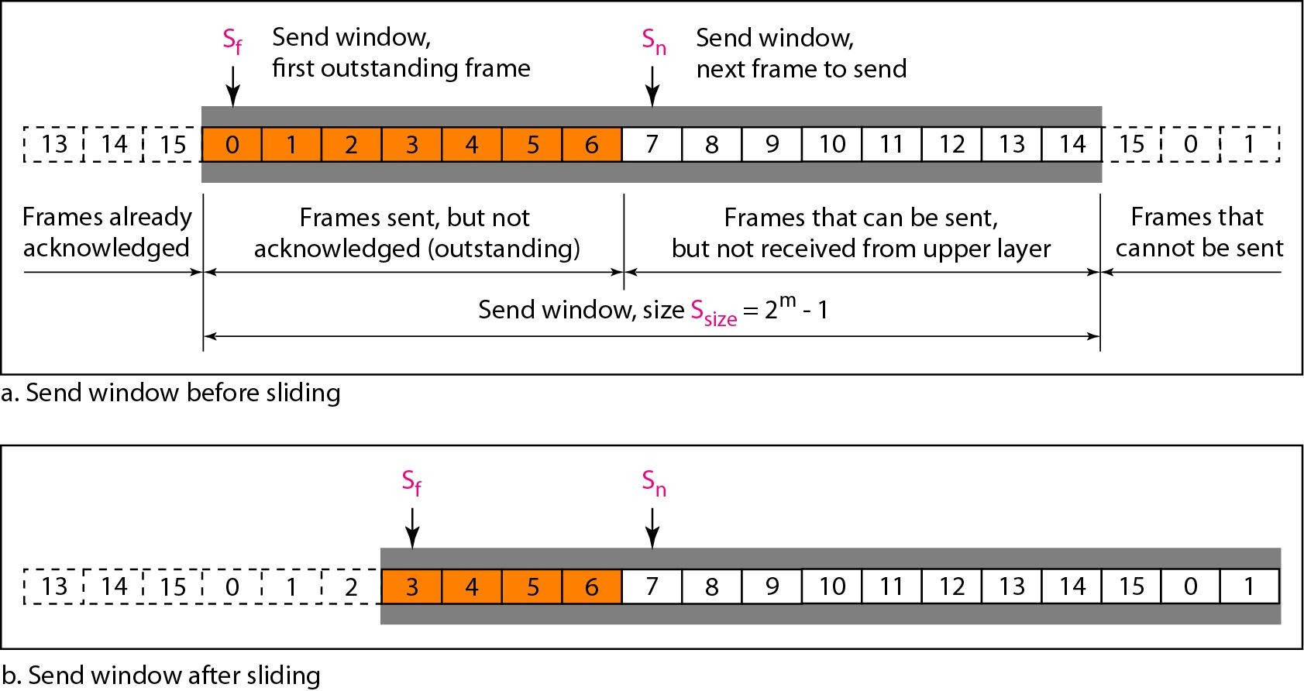
Figure 11.12 Send window for Go-Back-N ARQ

Slide 40

Note
The send window is an abstract concept defining an imaginary box of size 2^{m} − 1 with three variables: S_{f}, S_{n}, and S_{size}.

Slide 41
Note
The send window can slide one or more slots when a valid acknowledgment arrives.

Slide 42
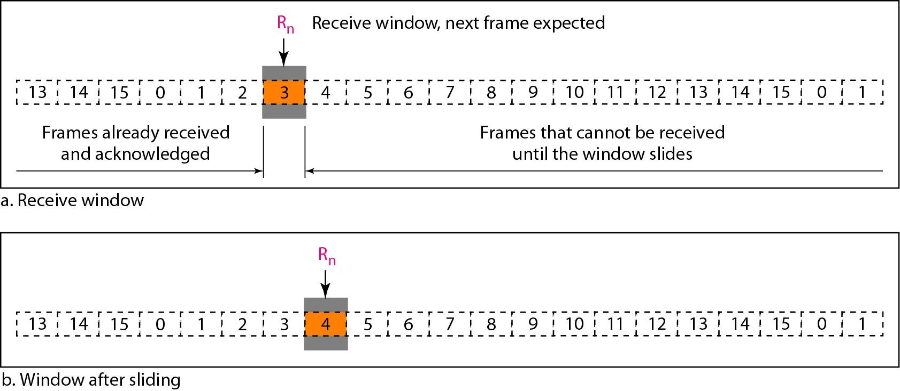
Figure 11.13 Receive window for Go-Back-N ARQ

Slide 43
Note
The receive window is an abstract concept defining an imaginary box of size 1 with one single variable R_{n}.
The window slides
when a correct frame has arrived; sliding occurs one slot at a time.

Slide 44
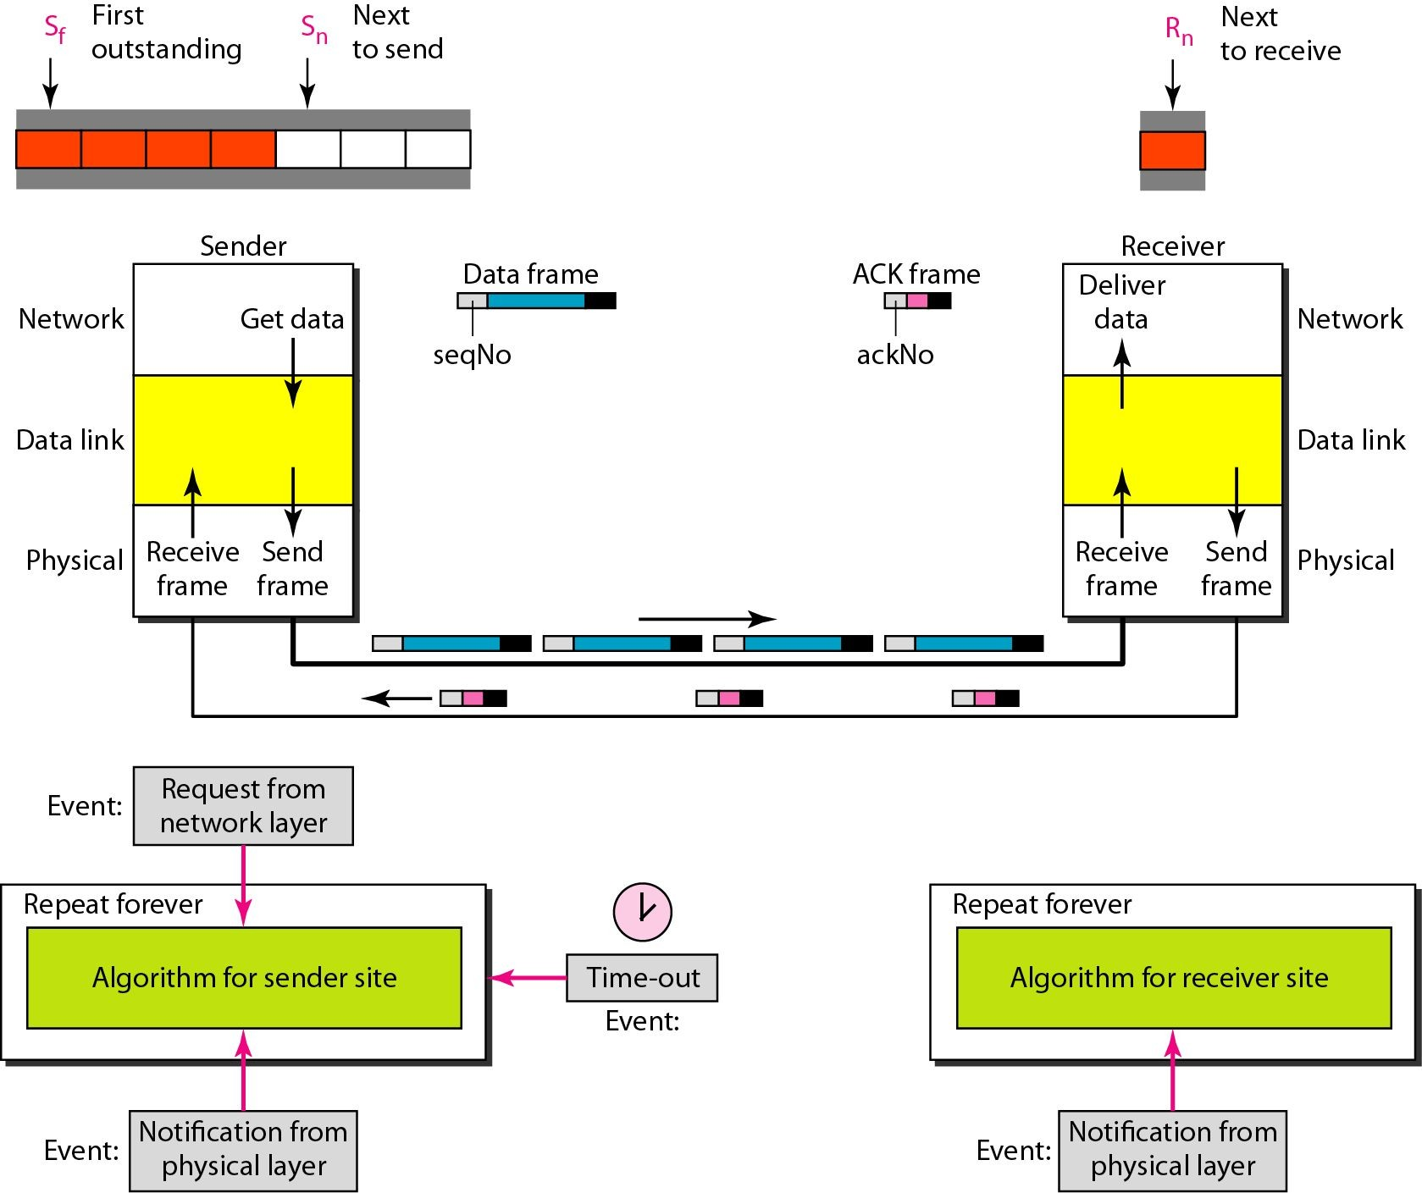
Figure 11.14 Design of Go-Back-N ARQ

Slide 45
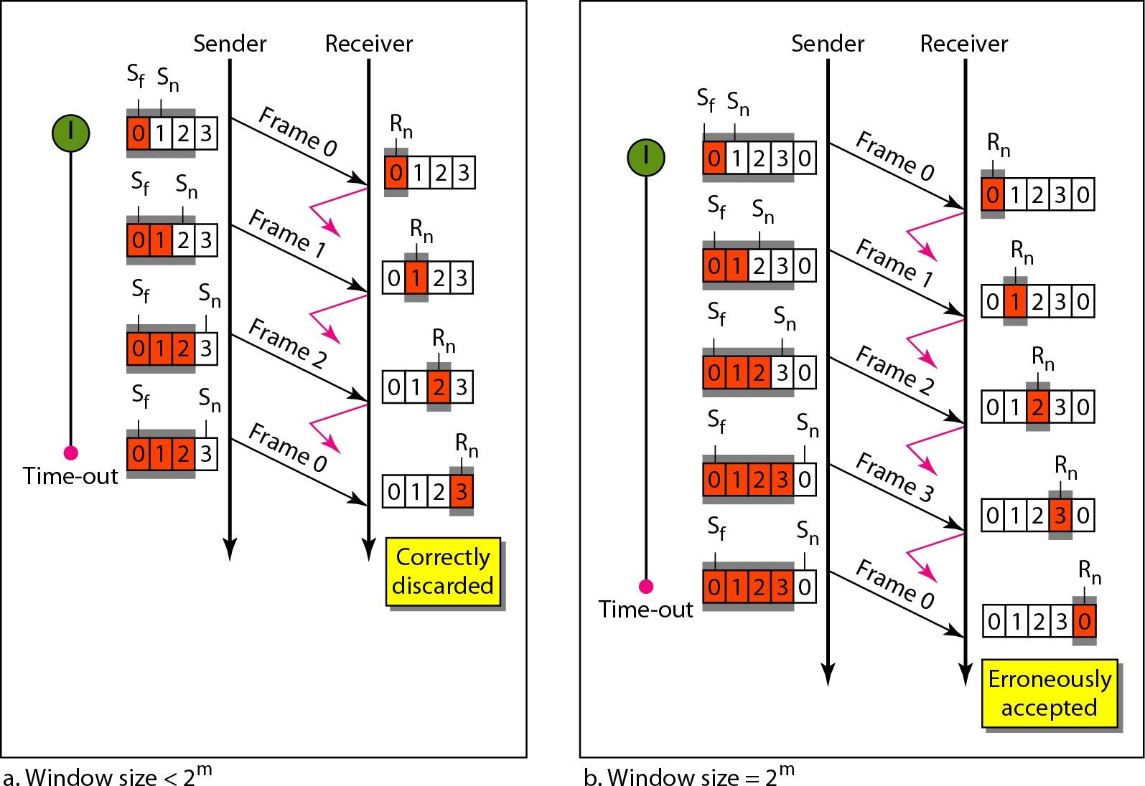
Figure 11.15 Window size for Go-Back-N ARQ

Slide 46
Note
In Go-Back-N ARQ, the size of the send window must be less than 2^{m};
the size of the receiver window is always 1.

Slide 47
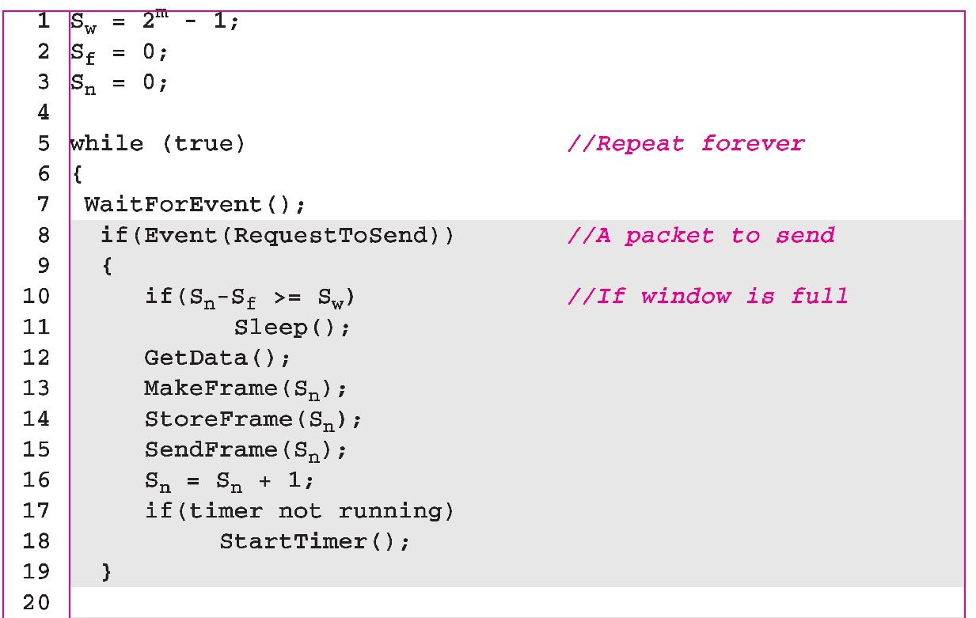
Algorithm 11.7 Go-Back-N sender algorithm
(continued

Slide 48
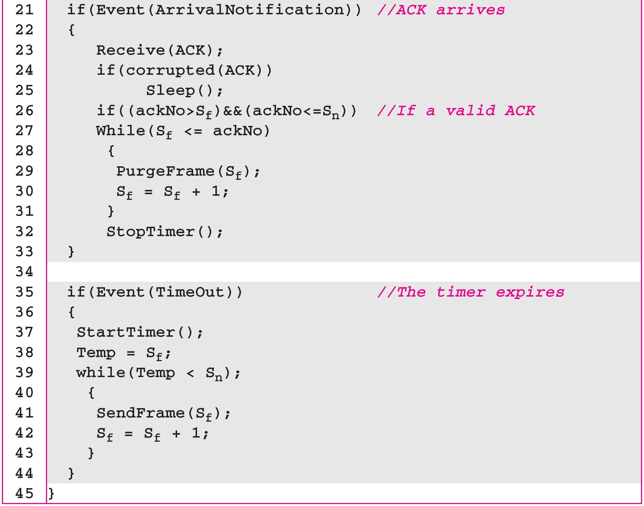
Algorithm 11.7 Go-Back-N sender algorithm
(continued
)

Slide 49
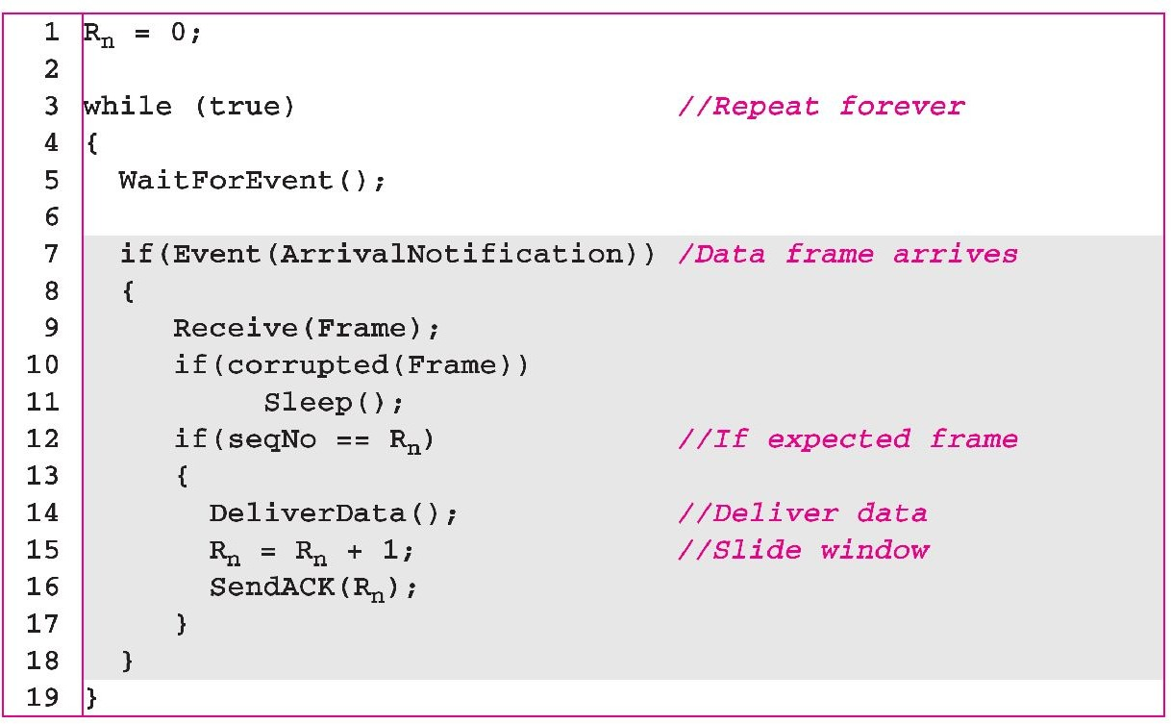
Algorithm 11.8 Go-Back-N receiver algorithm

Slide 50
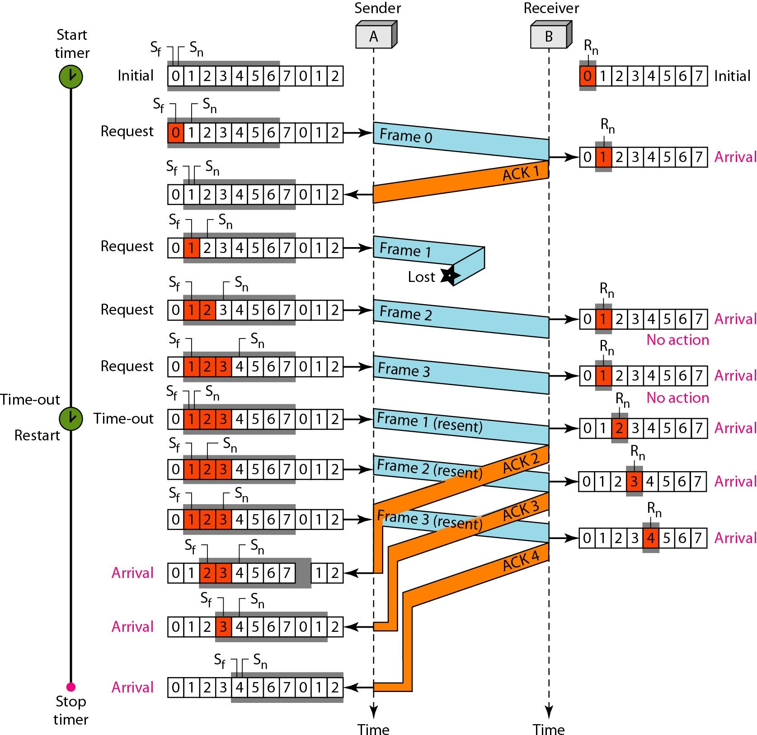
Figure 11.17 Flow diagram for Example 11.7

Slide 51
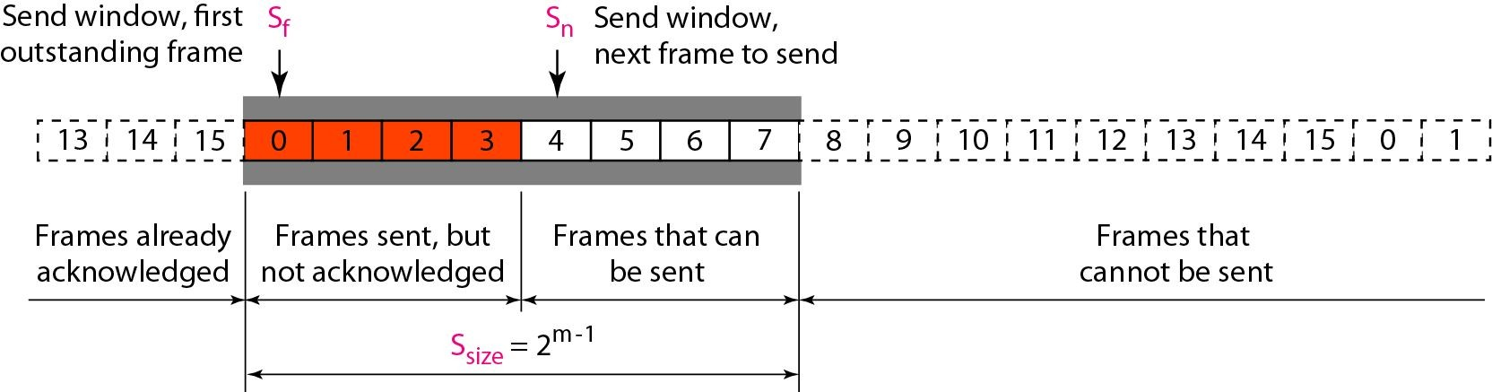
Figure 11.18 Send window for Selective Repeat ARQ

Slide 52
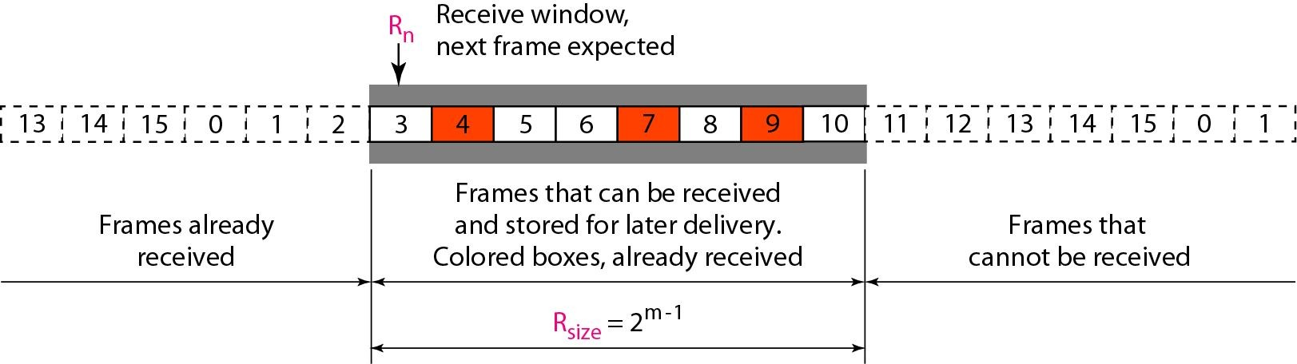
Figure 11.19 Receive window for Selective Repeat ARQ

Slide 53
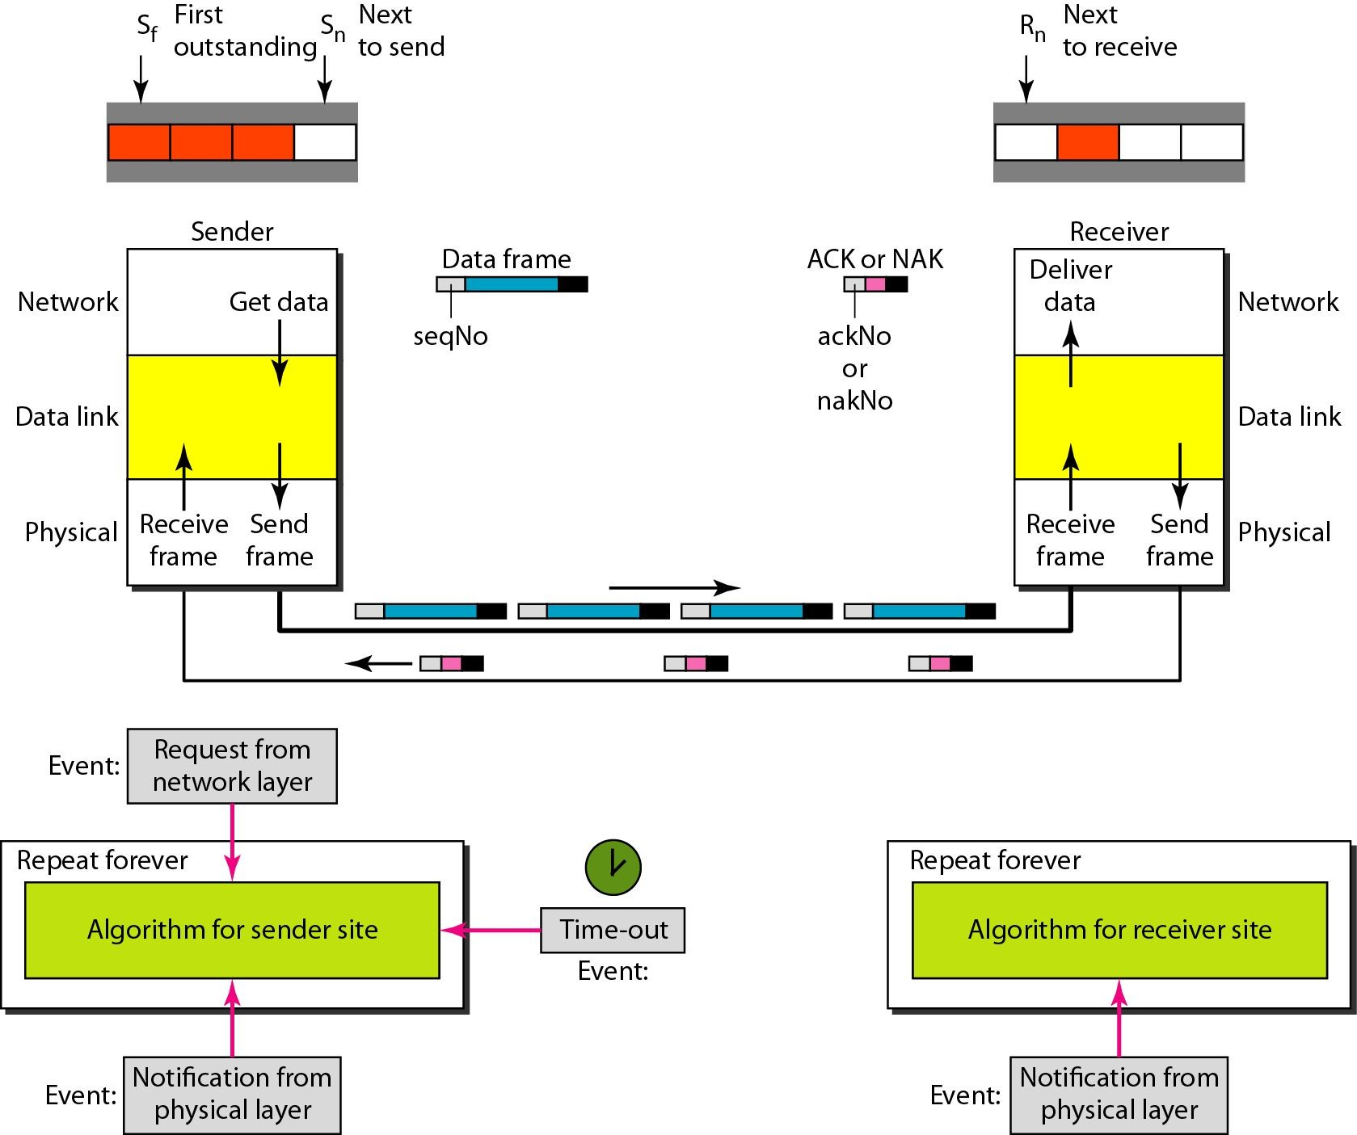
Figure 11.20 Design of Selective Repeat ARQ

Slide 54
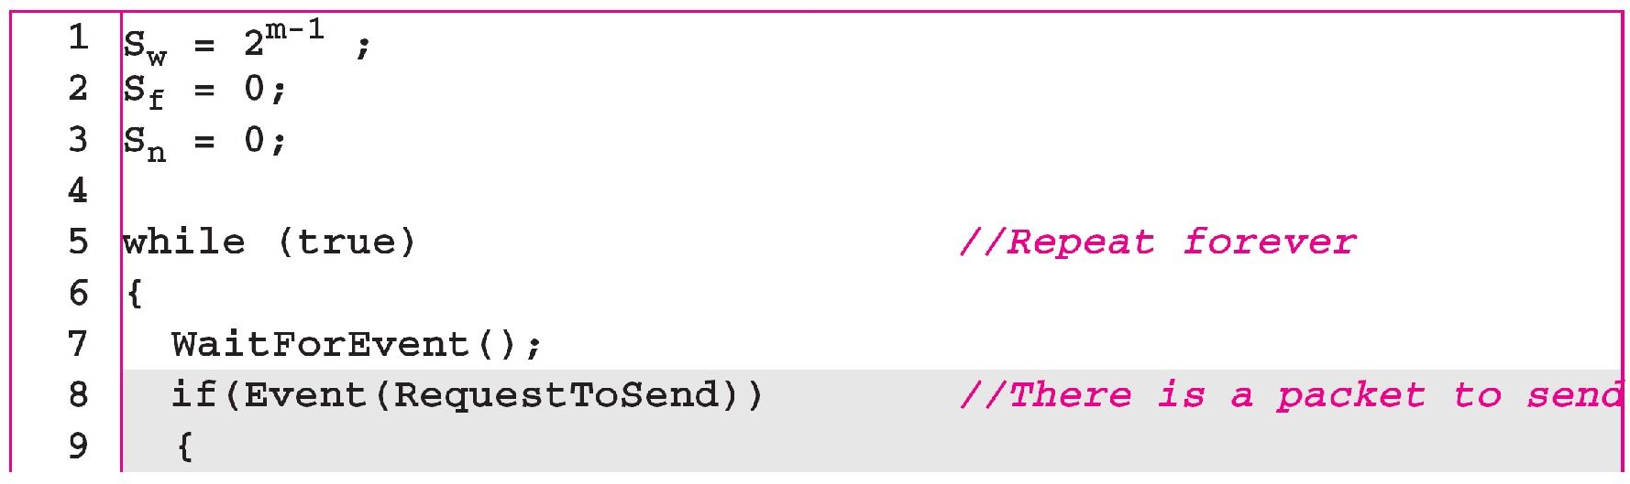
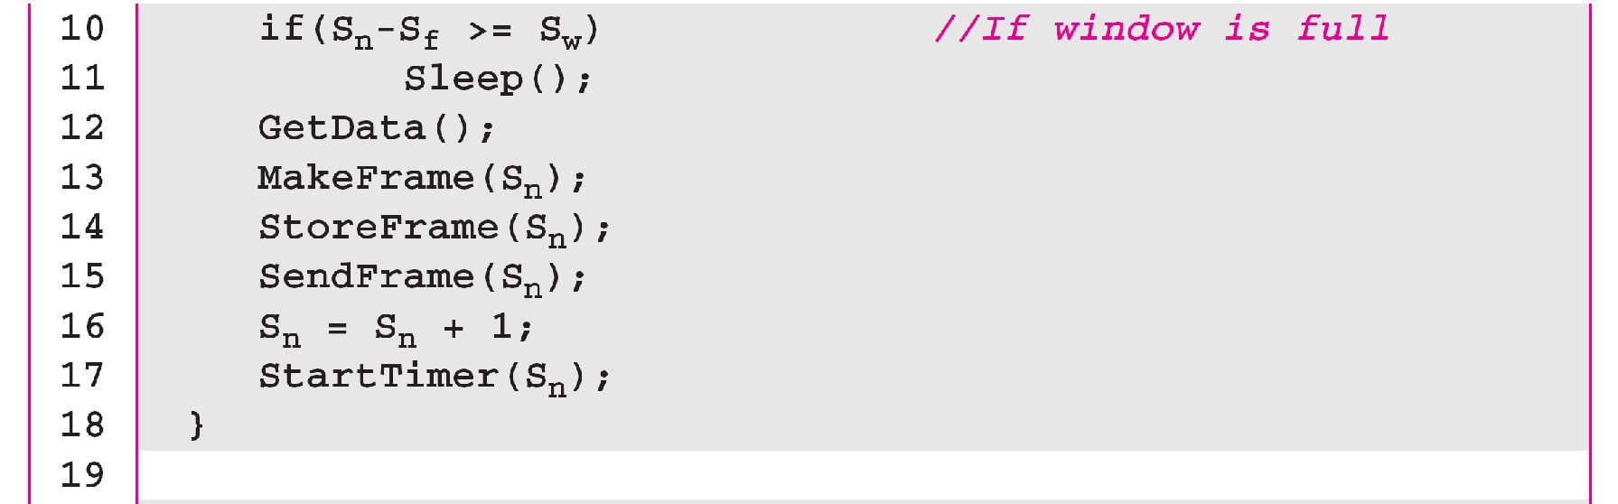
Algorithm 11.9 Sender-site Selective Repeat algorithm
(continued
11.54
)

Slide 55
Algorithm 11.9 Sender-site Selective Repeat algorithm
(continued
)
11.55
(continued

Slide 56
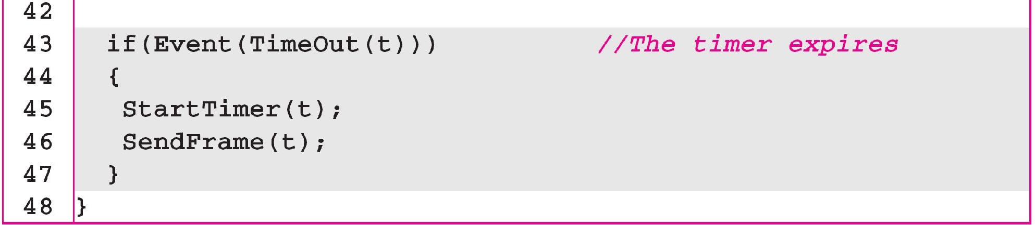
Algorithm 11.9 Sender-site Selective Repeat algorithm
(continued
)

Slide 57
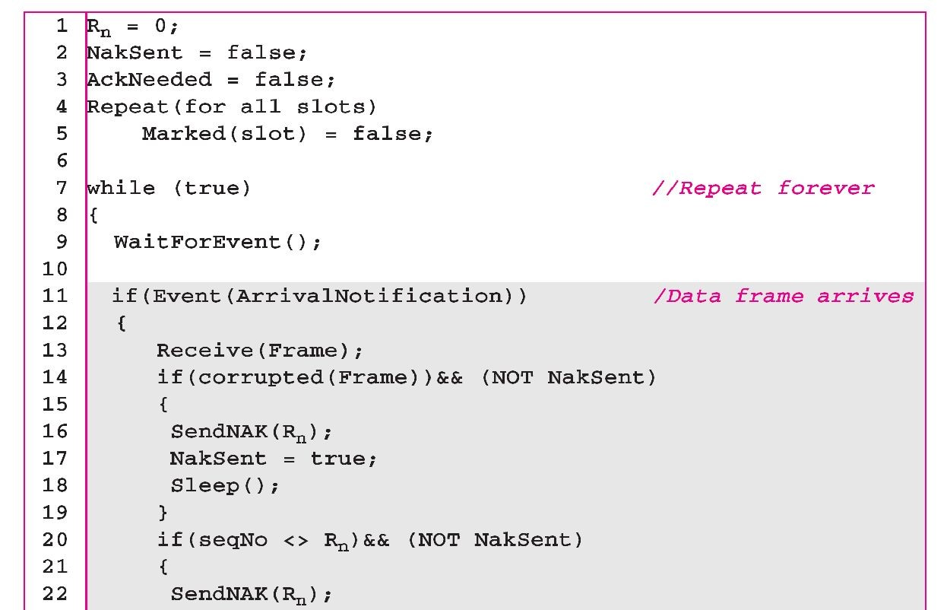
Algorithm 11.10 Receiver-site Selective Repeat algorithm

Slide 58
Algorithm 11.10 Receiver-site Selective Repeat algorithm

Slide 59
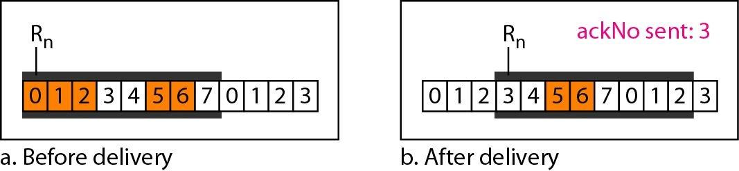
Figure 11.22 Delivery of data in Selective Repeat ARQ

Slide 60
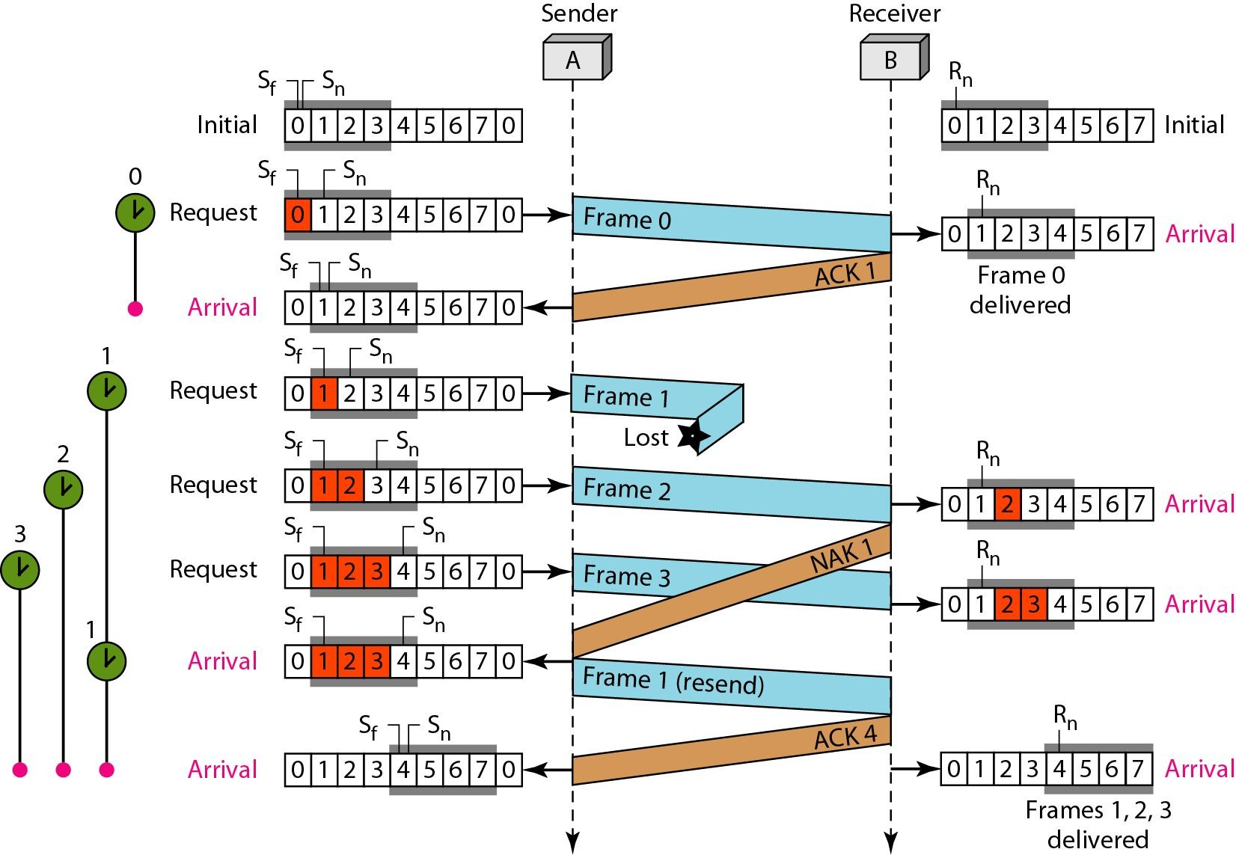
Figure 11.23 Flow diagram for Example 11.8

Slide 61
11-4 Point to Point Protocol (PPP)
□One of the most common protocols for point-to-point access is the Point-to-Point Protocol (PPP).
□Today, millions of Internet users who need to connect their home computers to the server of an Internet service provider use PPP.
□To control and manage the transfer of data, there is a need for a point-to-point protocol at the data-link layer. PPP is by far the most common.

Slide 62
Services
The designers of PPP have included several services to make it suitable for a point-to-point protocol, but have ignored some traditional services to make it simple.

Slide 63
Services provided by Point-point protocol
Defines
format of the frame to be exchanged between the devices.
How two devices can negotiate the establishment of the link and the exchange of data.
How N/W layer data are encapsulated in the data link frame.
How two devices can authenticate each other.
Provides Multiple N/W services supporting a variety of N/W Layer protocols.
Connection over multiple links is provided by new version of PPP.
N/W address configuration. Useful when a home user needs temporary N/W address to connect to Internet

Slide 64
Services not provided by ppp
PPP does not provide flow control. Sender can send frames one after another w/o concerning about overwhelming receivers buffer.
Simple mechanism for error control. A CRC field is used to detect errors. If frame is corrupted , frame is silently discarded. Upper Layer protocol need to take care of this.
Does not provide addressing mechanism to handle frames in a multipoint configuration.

Slide 65
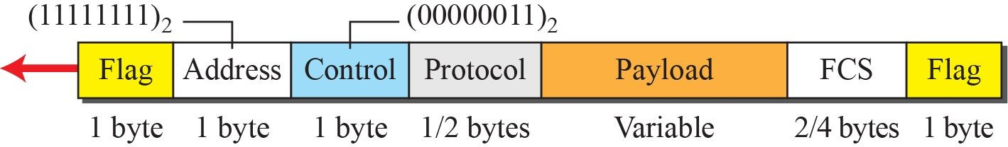
Framing
PPP frame format

Slide 66
□PPP uses a character-oriented (or byte-oriented) frame.
Framing
Figure below shows the format of a PPP frame. PPP is a byte oriented protocol
Flag:□ A PPP frame starts and ends with a one byte flag with the bit pattern 0111110. The flag is treated as a byte.
Address:□ The address field is constant value and set to 11111111(broadcast address)
Control□ The field is set to a constant value 11000000. PPP doe not provide FC and limited EC. Two parties can

Slide 67
Framing
Protocol□ defines what is being carried in the data field either user data or other information.
Default size is 2 bytes, two parties can negotiate to use only 1 byte. Payload field□ carries use data or other info.
Data field is a sequence of bytes with the default of maximum of 1500 bytes, But can be changed during negotiation.
The data field is byte stuffed if the flag byte pattern appears in the field. Because there is no field defining the size of the data field, padding is needed if the size is less than the maximum

Slide 68
Byte stuffing
In PPP flag is byte. The flag byte need to be escaped whenever it appears in the data section of the frame.
The escape byte is 01111101 , which means that every time the flag like pattern appears in the data, this extra byte is stuffed to tell the receiver the next byte is not a flag.
PPP is a byte-oriented protocol using byte stuffing with the escape byte 01111101.

Slide 69
Transition Phases
□A PPP connection goes through phases which can be shown in a transition phase diagram.

Slide 70
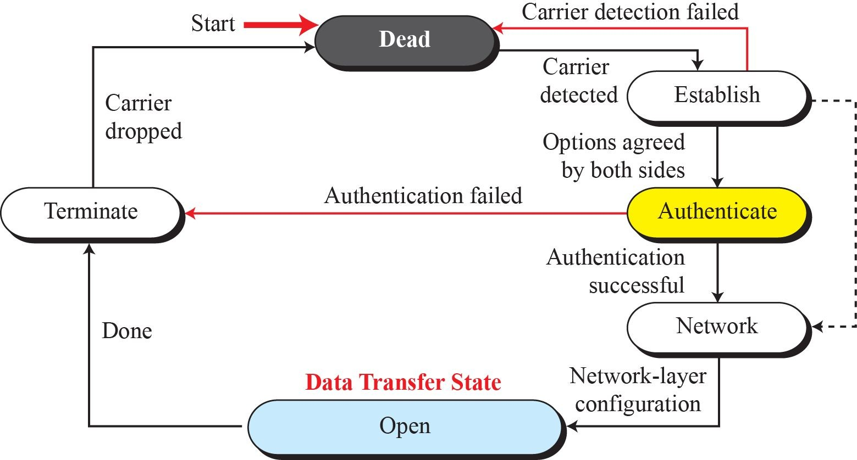
Transition phases

Slide 71
Transition phases
Dead: In this phase link is not used. There is no active carrier and line is quiet.
Establish: When one of the node starts communication, connection goes into establish phase. Options are negotiated between two parties.
If negotiation is successful, system goes to authentication phase or directly to networking phase. Link control packet are used in this phase.
Authenticate: Two nodes can negotiate and skip this phase as it is optional. If not to skip, authentication packets are used.

Slide 72
Transition phases
Network: Negotiation for the network layer protocols takes place. PPP specifies that two nodes establish a N/W agreement before data at the N/w can be exchanged.
PPP supports multi protocols at N/W Layer.
If a node is running multi protocol simultaneously at the N/W Layer, receiving node needs to know which protocol will receive the data.

Slide 73
Transition phases
Open: Data transfer takes place.
When a connection reaches this phase, exchange of data packets takes place
Connections remains in this phase until one of the endpoints wants to terminate the connection
Terminate: Connection is terminated. Several packets are exchanged b/w the two ends for house cleaning and closing of the link

